Slide 1

Green Pace
Security Policy Presentation
Developer: Alex Walrond
CS 405
Prof. Mimi
08/22/2024

Slide 2

OVERVIEW: DEFENSE IN DEPTH
Defense in depth is the approach to information security where security mechanisms are carefully and thoughtfully layered, in order to create a stronger protection against risk and possible vulnerabilities in a system.

Slide 3
THREATS MATRIX
PROBABILITY | SEVERITY | Severity
 | LOW HARM | MEDIUM HARM | HIGH HARM
LIKELY |  |  | STD-003-CPP STD-005-CPP
PROBABLE | STD-007-CPP |  | STD-002-CPP STD-004-CPP STD-009-CPP STD-010-CPP
UNLIKELY | STD-006-CLG | STD-008-CPP | STD-001-CPP

Slide 4
10 PRINCIPLES
Validate
Validate Input Data
STD-001-CPP, STD-002-CPP, STD-004-CPP
Heed
Heed Compiler Warnings
STD-003-CPP, STD-010-CPP
Architect and Design
Architect and Design for Security Policies
STD-009-CPP
Keep
Keep It Simple
STD-008-CPP
Default
Default Deny
STD-005-CPP
Adhere to the Principle of Least Privilege
Sanitize Data Sent to Other Systems
Practice Defense in Depth Validate Input Data
Use Effective Quality Assurance Techniques
Adopt a Secure Coding Standard
STD-005-CPP
STD-004-CPP
STD-010-CPP
STD-001-CPP, STD-002-CPP, STD-004-CPP STD-001-CPP, STD-002-CPP, STD-004-CPP
STD-004-CPP
STD-010-CPP
STD-004-CPP
STD-006-CLG

Slide 5
CODING STANDARDS
Rule | Severity | Likelihood | Remediation Cost | Priority | Level
STD-005-CPP | High | Likely | Medium | High (18) | 1
STD-003-CPP | High | Likely | Medium | High (18) | 1
STD-004-CPP | High | Probable | Medium | High (12) | 1
STD-002-CPP | High | Probable | Medium | High (12) | 1
STD-009-CPP | High | Probable | High | Medium (6) | 2
STD-010-CPP | High | Probable | High | Medium (6) | 2
STD-007-CPP | Low | Probable | Medium | Low (4) | 3
STD-001-CPP | High | Unlikely | High | Low (3) | 3
STD-008-CPP | Medium | Unlikely | Medium | Low (4) | 3
STD-006-CLG | Low | Unlikely | High | Low (1) | 3

Slide 6
ENCRYPTION POLICIES
Encryption in rest - Protects stored data.
Hard drives, phones, computers, cloud assets, etc.
Encryption at flight - Protecting data that is moving.
Devices within a network or moving outside of a network.
Encryption in use - Protects data that is created, edited, or otherwise defined as in-use.
Ensuring protection is in place prior to use.
Source: https://www.mimecast.com/blog/data-in-transit-vs-motion-vs-rest/

Slide 7
TRIPLE-A POLICIES
Authentication - The act of confirming one’s identity.
Ensure a person is who they claim to be.
Authorization - Specifies the access rights and privileges of a user and are an important part of information and computer security.
What a user can and cannot access
Accounting - The process of keeping track of activity while interacting with a system, showing timestamps, accessed resources, and data transfer information.
Bread crumb trail of activity.
Source: https://www.ccsinet.com/blog/aaa-identity-management/

Slide 8
Unit Testing
Unit testing – Verify and validate components of a program or application, in order to ensure the app will act and respond as intended.
Testing done with Google Test (gtest):
https://github.com/google/googletest/

Slide 9
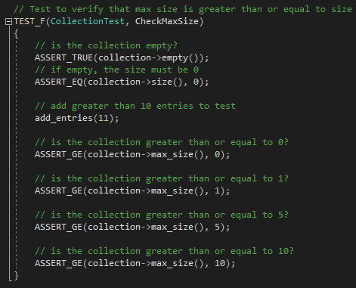
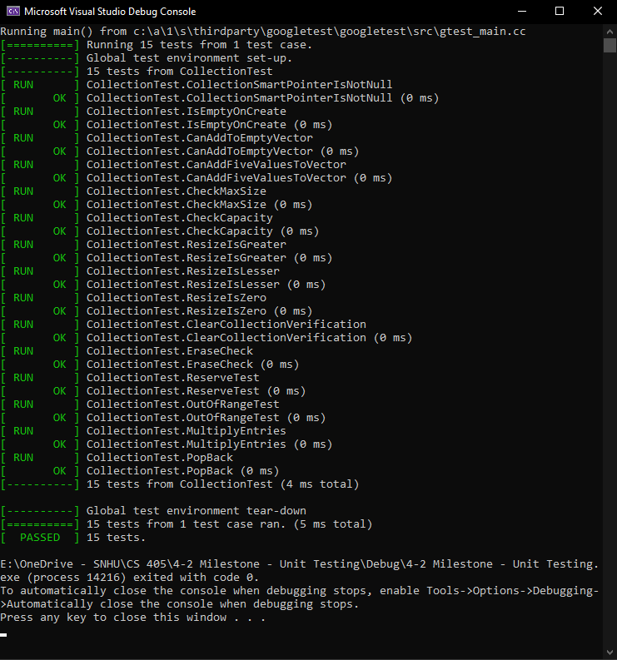
Check Max Size
Test to verify max size is greater or equal to size for x number of entries.

Slide 10
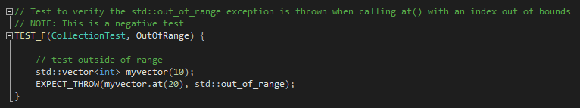
Out Of Range
Test to verify an out-of-range exception is thrown when calling out of bounds.

Slide 11

AUTOMATION SUMMARY

Slide 12
TOOLS
“DevSecOps means thinking about application and infrastructure security from the start.”
RedHat.com
CPPCheck: static code analysis (https://cppcheck.sourceforge.io/)
Clang: front-end compiler (https://clang.llvm.org/)
Parasoft: automated testing suite (https://www.parasoft.com/)

Slide 13
RISKS AND BENEFITS
Risk of waiting:
Harm to data
Harm to customer trust
Financial cost
Potential future damages of multiple attacks
Benefits of early action:
Mitigate possible damage
Prevent threats
Create structure and consistency in security
Reduce possible testing overhead
Example case:
Adobe 2013 Data Breach
Date of case:
Result:
Over 150 million users impacted by the data breach, as well as a financial compensation as part of a settlement.
October 2013
Source: https://www.csoonline.com/article/2130877/the-biggest-data-breaches-of-the-21st-century.html/

Slide 14
RECOMMENDATIONS
Possible Gaps in Security Policy:
Policy is a solid foundation. Should be subject to regular reviews and updates, or as gaps are identified.
Annual checks from an outside source, such as a white hat security firm, will help to give security a real-world test and find possible vulnerabilities.
Early application of these policies will help to ensure security is consistently at the forefront of progress.

Slide 15
CONCLUSIONS
Adopting best practices and coding standards, defense in depth, constant consideration to motive of potential attack, and keeping a “no one is safe” attitude towards security and prevention throughout development will help to transform DevOps into DevSecOps at Green Pace.

Slide 16
REFERENCES
Argintaru, D. (2021). Data Encryption: How to Protect Data in Transit, Data in Use and Data at Rest. Mimecast.com. https://www.mimecast.com/blog/data-in-transit-vs-motion-vs-rest/
Authentication, Authorization, Accounting and Identity Management. (2018, April 3). CCSI. https://www.ccsinet.com/blog/aaa-identity-management/
Fogg, E. (2021, May 11). What Can and Should be Automated in Software Development? ProdPerfect. https://prodperfect.com/blog/test-development/automated-software-development/#:~:text=Automating%20part%20of%20your%20application’s,quality%20of%20your%20test%20suite
Hill, M. (2021, July 16). The 15 biggest data breaches of the 21st century. CSO Online. https://www.csoonline.com/article/2130877/the-biggest-data-breaches-of-the-21st-century.html
What is DevSecOps? (2021). Redhat.com. https://www.redhat.com/en/topics/devops/what-is-devsecops

